Slide 1


D
a
a
t
SLC 2021 Crime Data Analysis
Camille Floyd Fridencio Loza Yao Li
Group
s
s

Slide 2





Data Source
OpenWeather API
FBI's Uniform Crime Reporting (UCR) program
U.S. Census Bureau
Group

Slide 3
Statistical Modeling Techniques
Linear regression
Time series analysis
Generalized linear model
Clustering
Group

Slide 4
Group

Slide 5
Group

Slide 6

Weather
Group

Slide 7
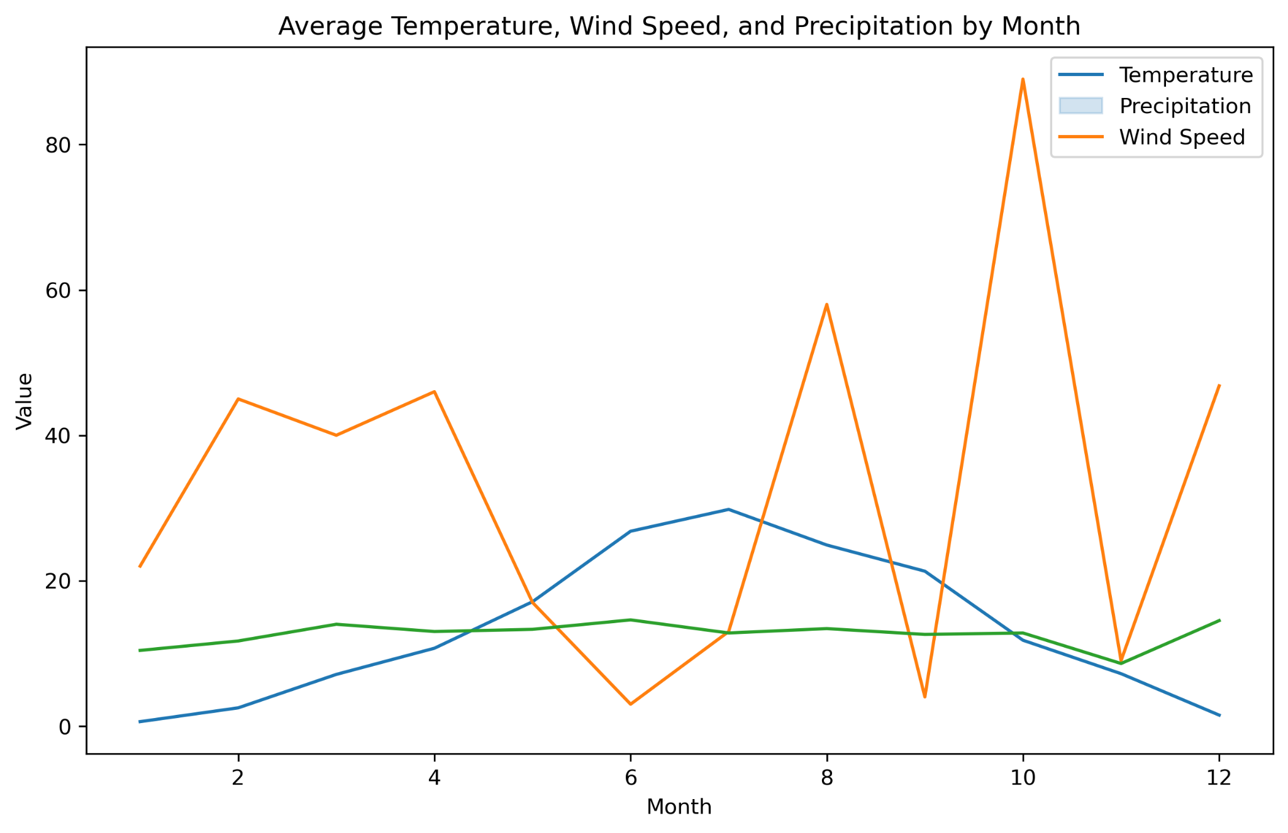
Group

Slide 8
Group

Slide 9
Group

Slide 10
Group

Slide 11
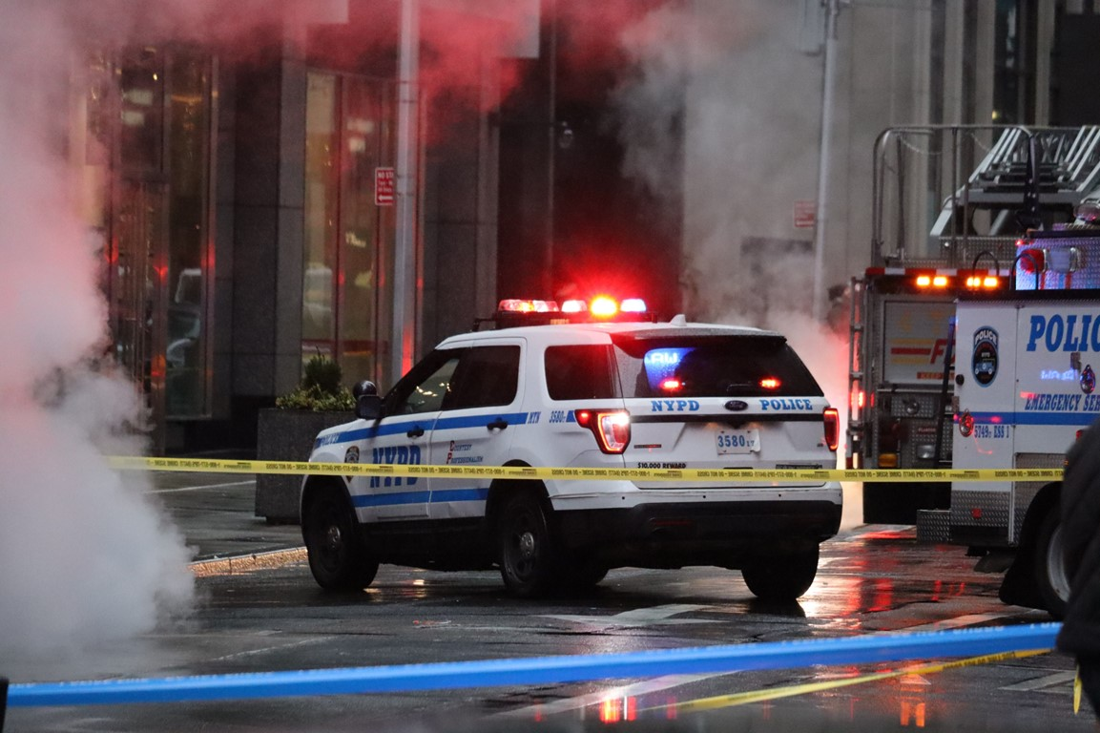
Crime
The analysis found that the mean crime rate for each city in 2021 was as follows:
NORTH SALT LAKE: 7773.67
SALT LAKE CITY: 52861.82
SALT LAKE CNTY UNIFD PD: 3396.26
SOUTH SALT LAKE: 4489.46
Group

Slide 12
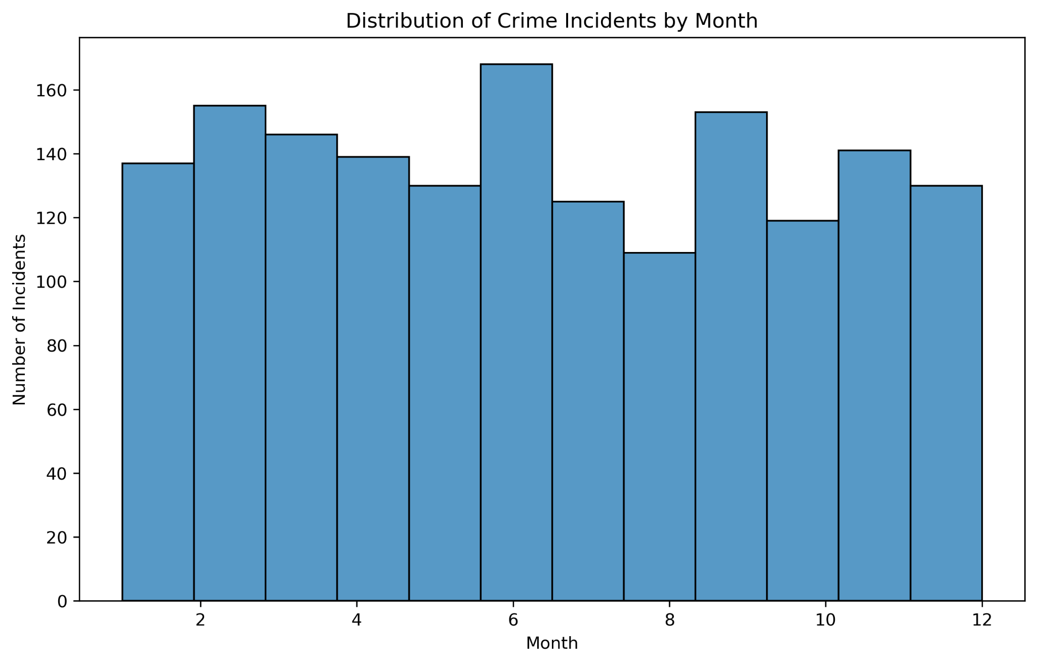
Crime incidents were highest during the summer months and lowest during the winter months.
Group

Slide 13
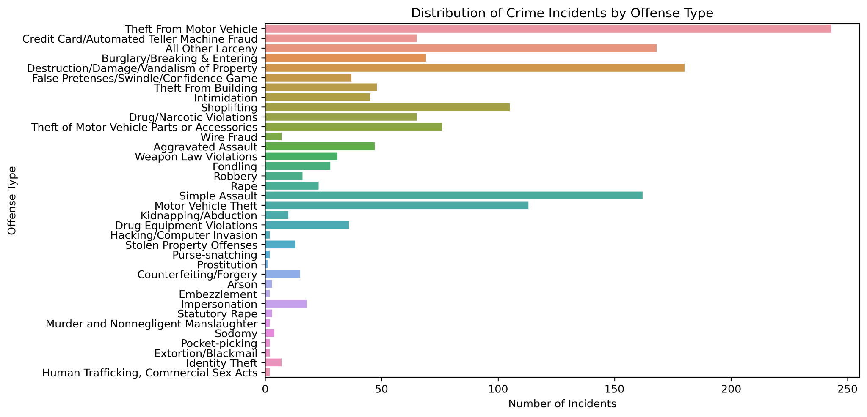
Group

Slide 14
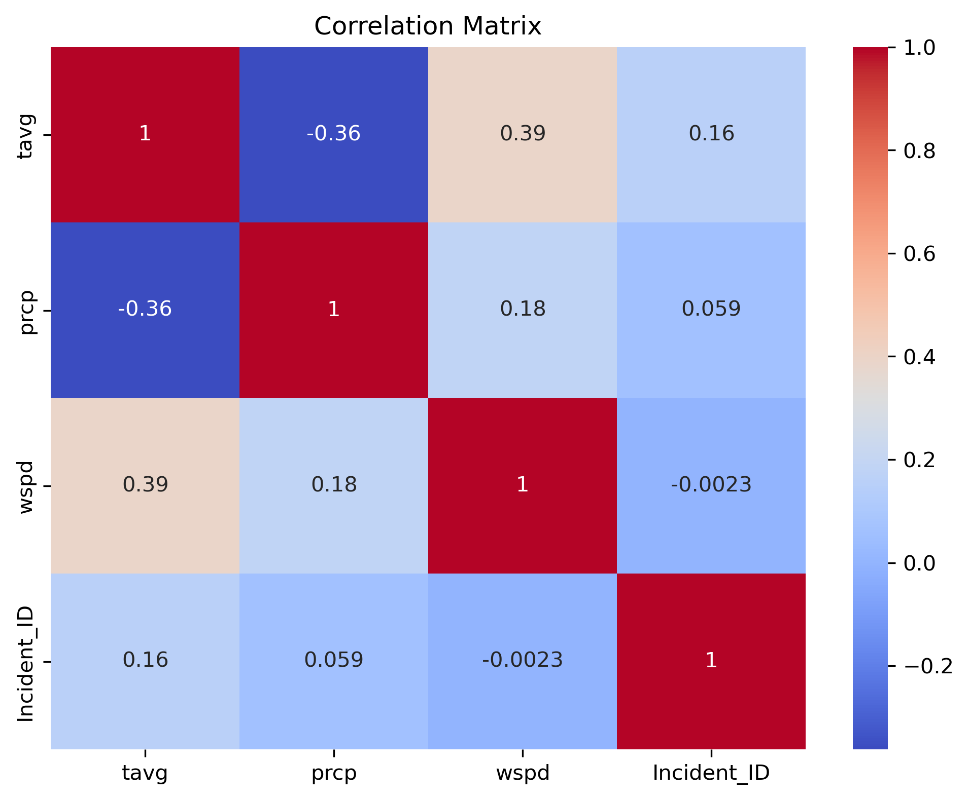
Correlation matrix
the correlation matrix between the variables showed a weak positive correlation between temperature and incident ID.
temperature, precipitation, wind speed, and incident ID
Group

Slide 15
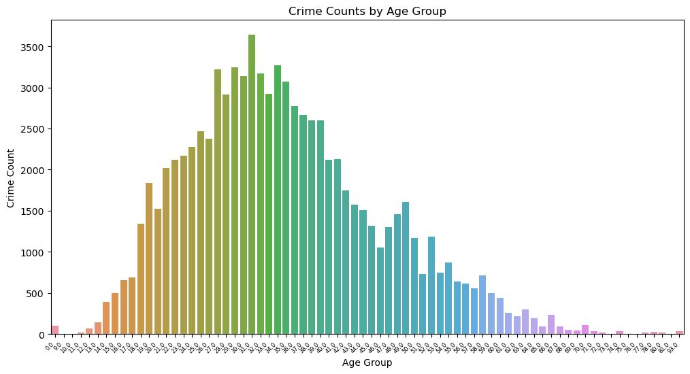
Group

Slide 16

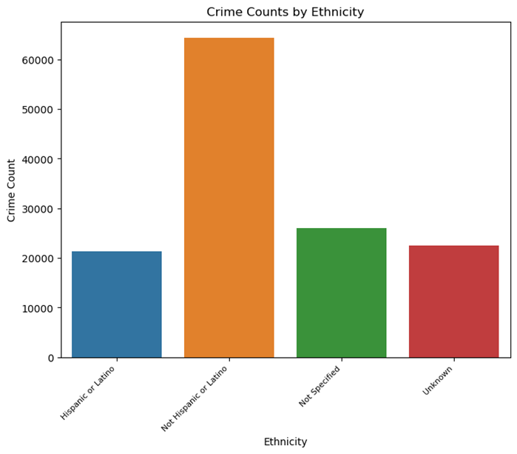
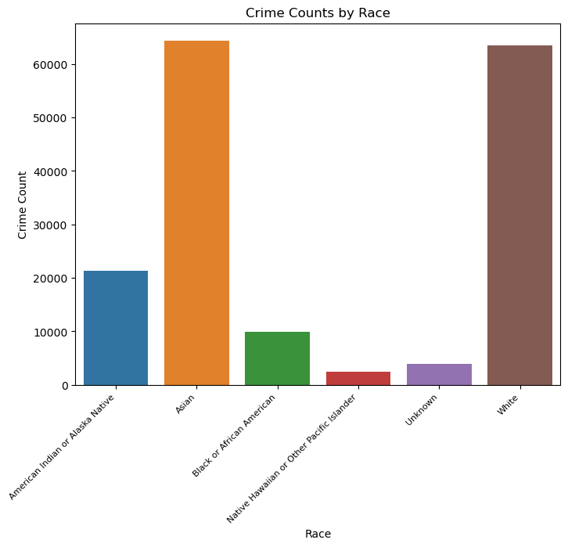
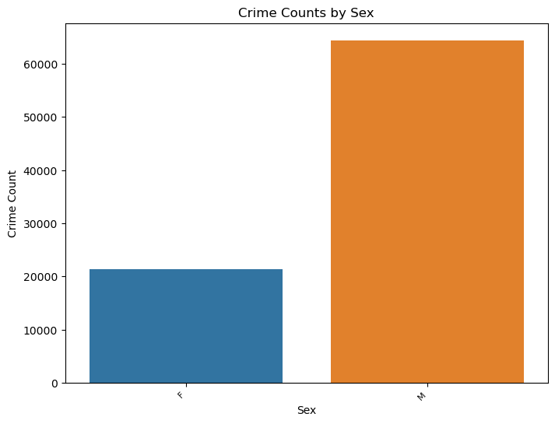
Group

Slide 17
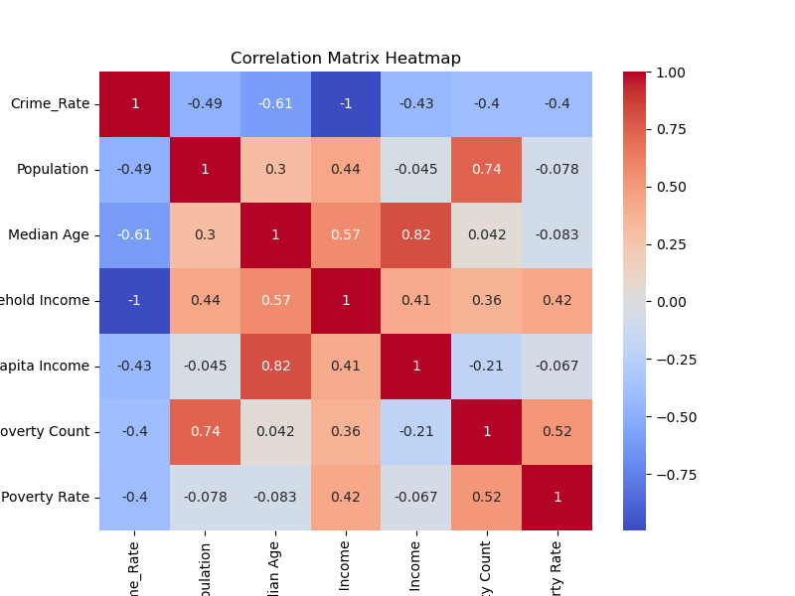
The heatmap shows strong positive correlations between population and crime rate.
It also shows a weak negative correlation between median age and crime rate.
Group

Slide 18
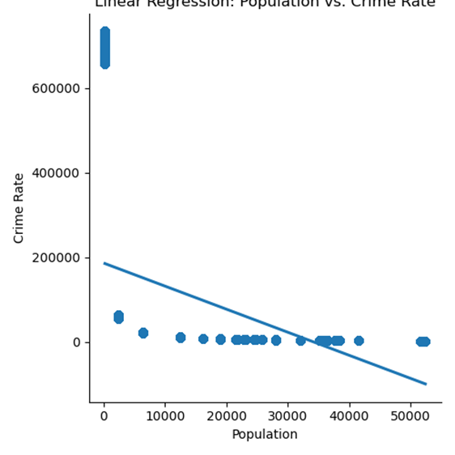
Group

Slide 19
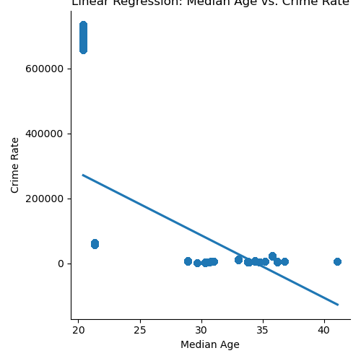
Group

Slide 20
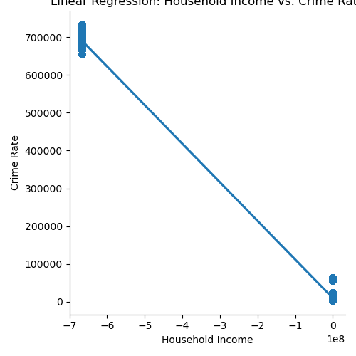
Group

Slide 21
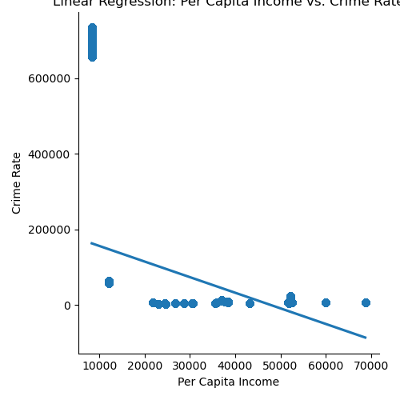
Group

Slide 22
Group

Slide 23
Group

Slide 24
Group

Slide 25
Group

Slide 26
Group

Slide 27
Group

Slide 28
Group

Slide 29
Group

Slide 30
Group

Slide 31
Group

Slide 32
Group

Slide 33
Group

